Slide 1




Phoenix
A Study of Heat Islands
Through Small Satellite Technology
Project Manager: Sarah Rogers
Project Investigator: Dr.Judd Bowman
Arizona NASA Space Grant Consortium
April 22, 2017
Notes:
7 min long
Rule – 1 min/slide
Think of transitiosn

Slide 2
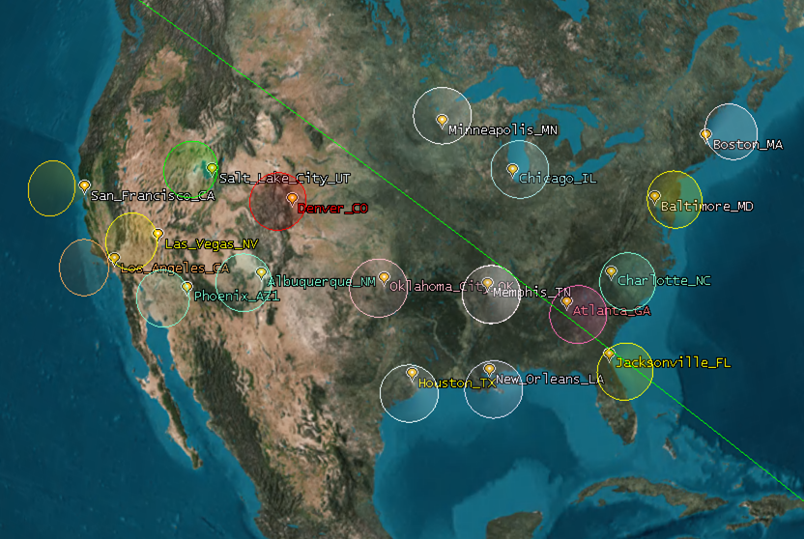
Program Background
    3U CubeSat developed by undergraduates at ASU
    Objective: To study the Urban Heat Island (UHI) Effect through infrared remote sensing
Student Flight Research Opportunity funded by the NASA USIP Program and Space Grant Consortium
    Launch readiness date: March 8, 2018
Launch date: Summer 2018 (desired)
Mission lifetime: 6 months – 1 year (desired)
Orbit: ISS Orbit (400km altitude, 51.6° inclination)
Projected data volume: 2,000-4,000 images over mission lifetime
  City Analysis: Phoenix, Los Angeles, Chicago, Baltimore, Minneapolis, Atlanta, Houston, Boston, Jacksonville, Denver, San Francisco, Albuquerque, Memphis, New Orleans, Oklahoma City, Charlotte, Las Vegas, and Salt Lake City

Slide 3
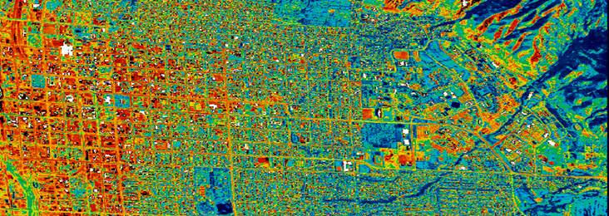
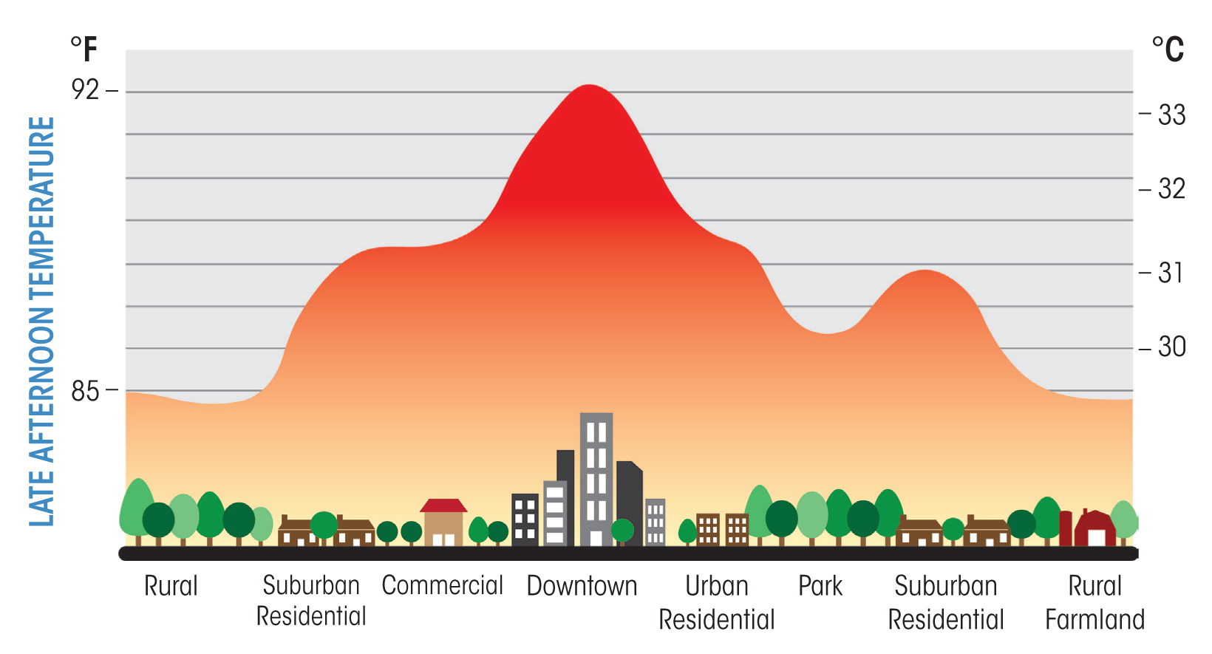
The Importance of UHIs
Urban core is warmer than surrounding rural temperature
Links to heat exhaustion, detriments to air quality, increased energy consumption
Rises in the UHI Effect: directly linked to human activity, matierial emissivity, and city planning
Incoming solar flux is stored in asphalt, structures and released during the evening (around 8pm)
Program goal: to provide a stepping stone into sculpting more sustainable cities
Image sources: UHI map of Salt Lake City (above) – NASA, UHI diagram (below) – Southwest Urban Hydrology

Slide 4
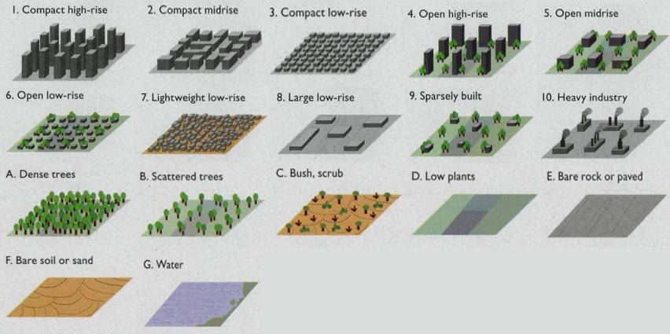
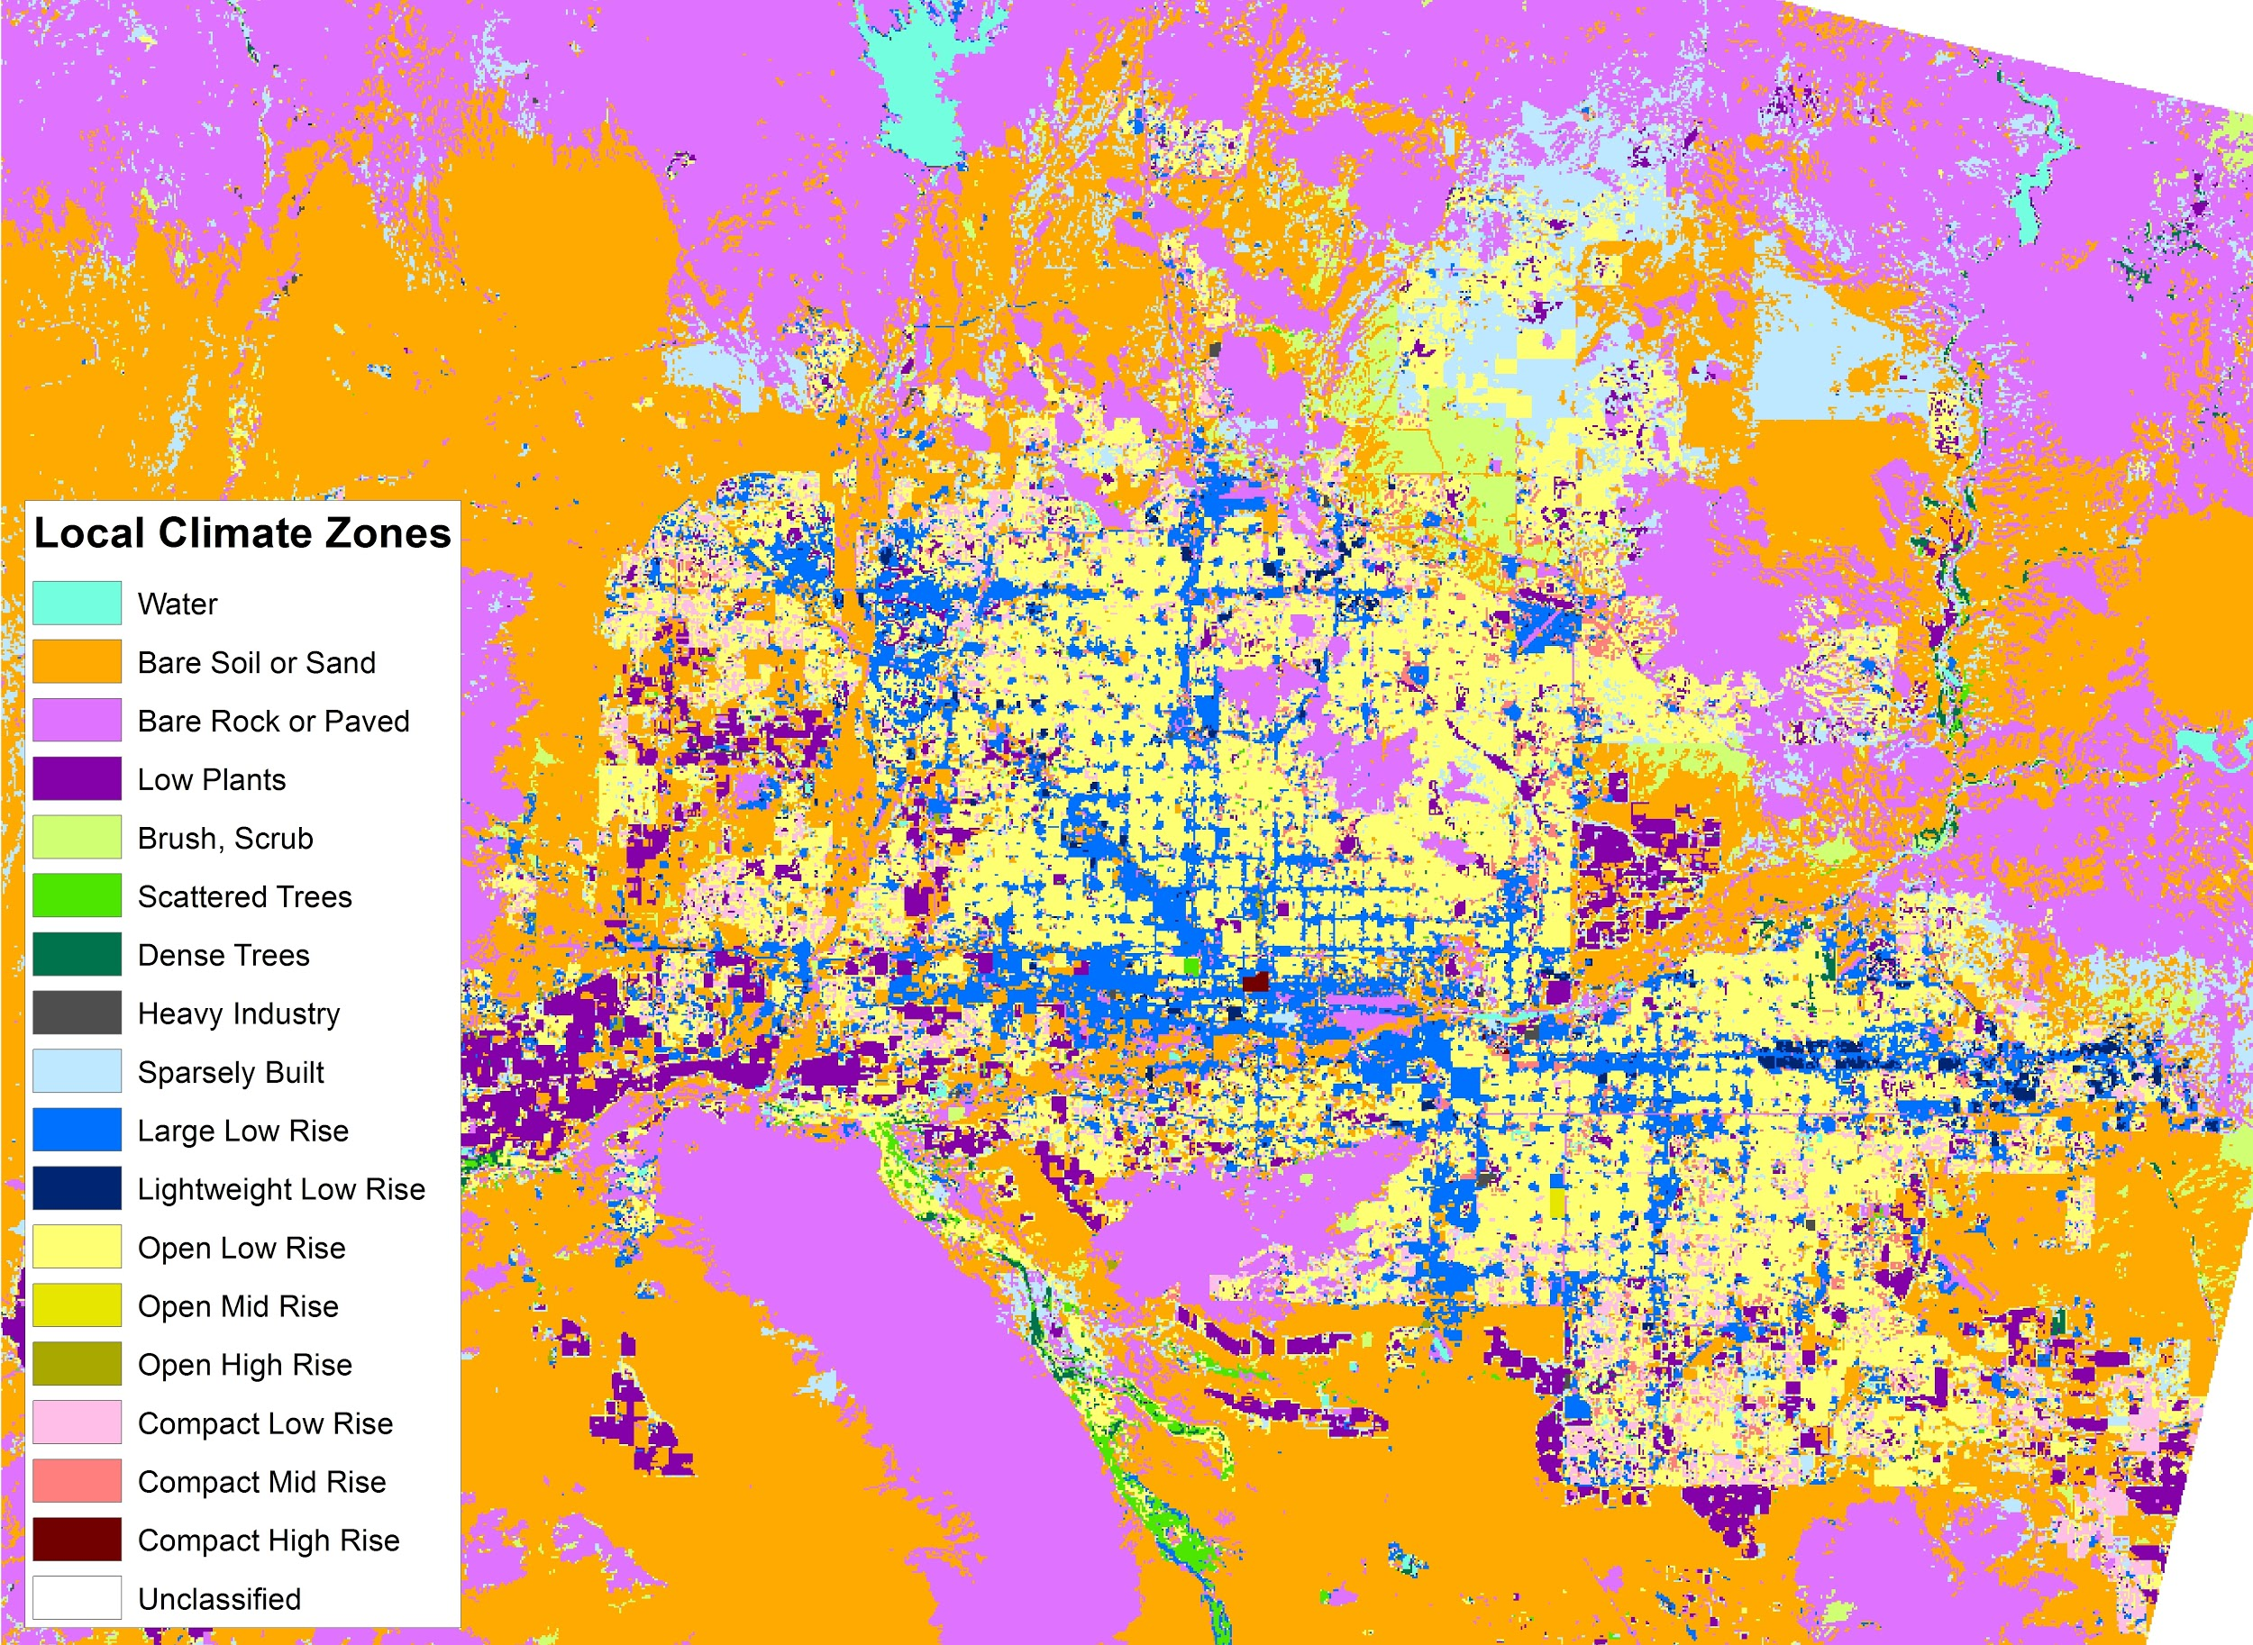
Analysis of Local Climate Zones (LCZs)
                Cities are complex and diverse - LCZs allow scientists to classify an area
                17 land classifications, in total, each with its own characterization
Science Objective:
  Phoenix will study the heat distribution within a city based on its various LCZs to assess the causes of the UHI Effect
  Captured thermal images will be overlaid with maps of city LCZs to analyze the heat distribution during the day
Image sources: LCZ classifications (above) – T. Oke, LCZ model of Phoenix, AZ (left) Dr. Ariane Middel (ASU)
Notes:
SLIDE - LCZS ALLOW SCIENTISTS TO CLASSIFY AN AREA

Slide 5
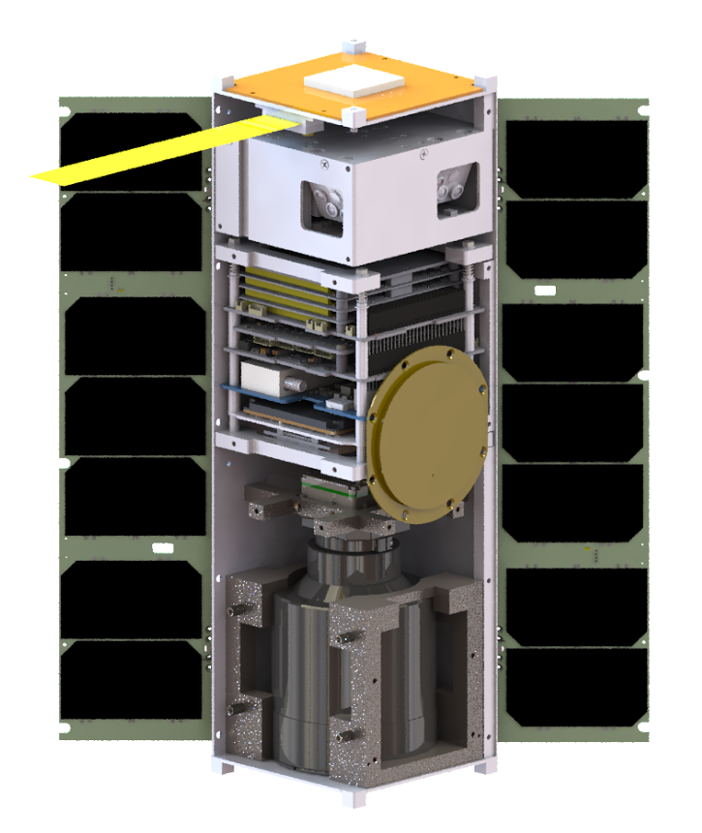
Satellite Design
GPS Antenna
MAI-400 ADCS
UHF Antenna
S-band Patch Antenna
Li-Ion Batteries
EPS
On Board Computer
UHF Radio
Motherboard
GPS Receiver
S-band Transmitter
FLIR Tau 2 640 IR Camera
135° Deployable solar panels
Notes:
Commercial off the shelf components – limitations have caused us to make parts for ourselves
Student team is making the chassis and mounting structure
Making UHF antenna

Slide 6
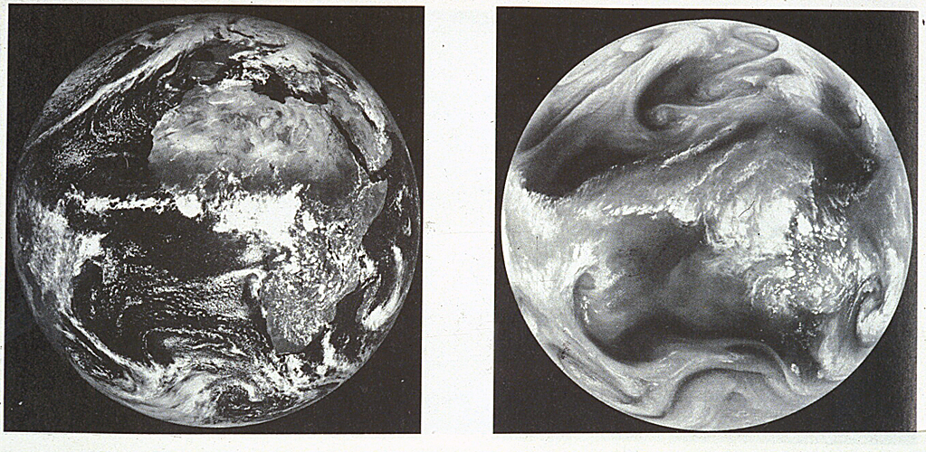
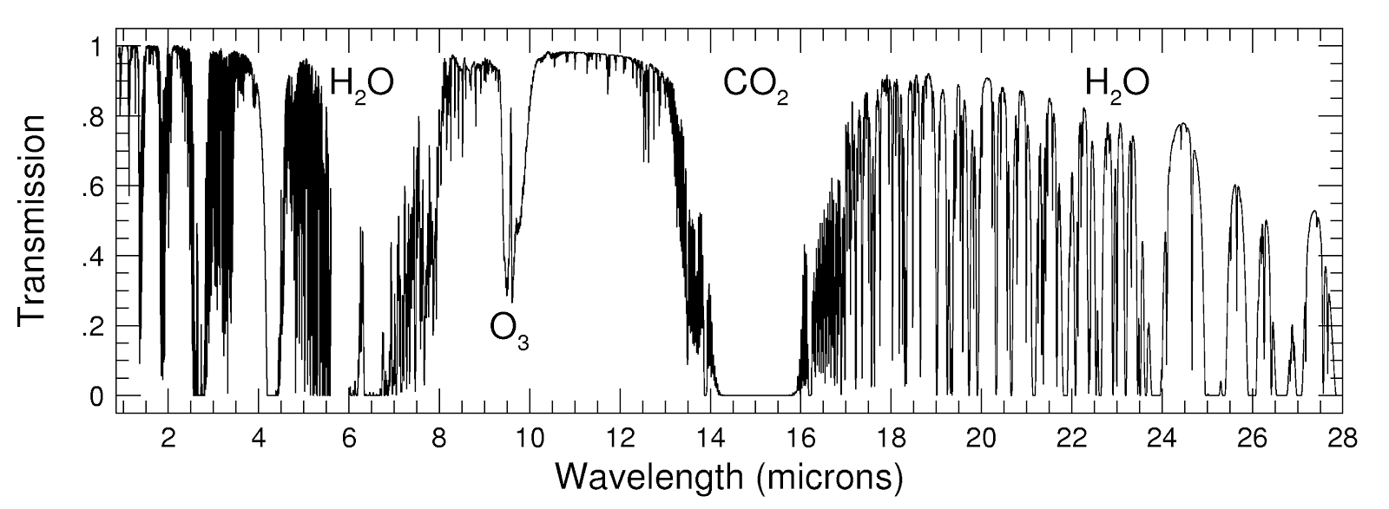
Infrared Remote Sensing from Space
Atmosphere is complex, filtering is needed to reduce interferences of ozone gasses
                Must obtain ground truth to accurately interpret the Earth’s surface
Payload – uncooled microbolometer from FLIR technologies
Camera detector absorbs incoming photons when an image is captured of the surface
Gathered photons are interpreted as heat flux values, then turned into temperature values
Large temperature fluctuations around the payload make data unusable
Payload wavelength (7.5–13.5μm)
Desired wavelength (10.5-12.5μm)
Image source: Earth in the IR, University of Colorado Boulder
Image Source: IR Wavelength response, NASA
Notes:
Remote sensing from space – hard, lots of interference
How ground truths help

Slide 7
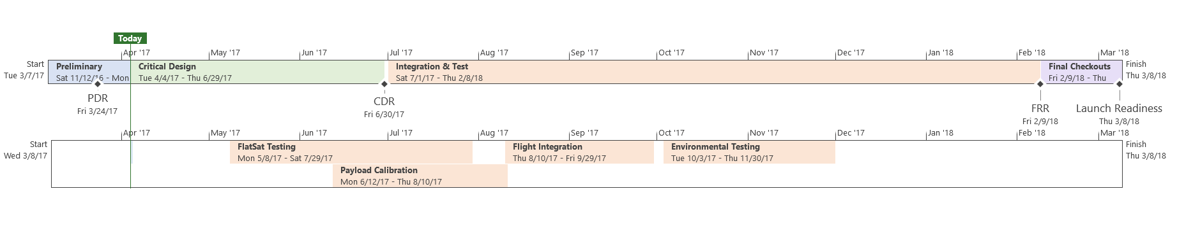
Path to Launch Readiness
Phoenix Timeline
Upcoming challenges:
Hardware interfaces
Payload calibration
Environmental Testing – thermal vacuum, vibrations
Preparation for mission operations
Notes:
What’s next for phoenix?
More importantly, why is this timeline necessary, how does it factor into the program management
Our timeline must be this way

Slide 8
CubeSat Conclusions – Keys to Success
CubeSats can do significant science at low cost and higher risk, but the extent to which they can achieve a science goal must be strongly weighed
Keep your goal in mind, and keep it manageable
Never be afraid to ask questions!
There is much to be learned from heritage, but the best understanding will come from your own application of thought
Notes:
Leaned on mentors for advice, but had to make objective decisions for ourselves,
The scope of the project became much greater than any of us imagined– we had to make sure that as undergrads, we kept the program manageable so it could achieve success
The best discussions were had from sitting in a room and organizing a flight scenario

Slide 9
Acknowledgements
Dr. Judd Bowman
Dr. Paul Scowen
Dr. Thomas Sharp
Dr. Christopher Groppi
Dr. James Bell
Hannah Kerner
Mike Veto
Andrew Ryan
Johnathon Hill
Danny Jacobs
Dr. Erinanne Saffell
Dr. Ariane Middel
Justin Foley (Cal Poly)
Julie Castillo (JPL)
Travis Imken (JPL)
Henry Hallam (Planet)
Ryan McLinko (Planet)
Dr. Lance Gharavi
Dr. Jake Pinholster
Peter Dell (USIP Platform Manager)
Notes:
Remember your mentor, any graduate students, the funding agency, the Department, the name of the grant, etc

Slide 10




Questions?
phxcubesat.asu.edu
@PHXSAT
@PHXSAT
@PHXSAT
Notes:
Questions slide

